Slide 1
Intro to Active Record
Less SQL, more CRUD.

Slide 2
Contents
What is ActiveRecord?
CRUD with ActiveRecord
ActiveRecord Migrations

Slide 3
Contents
What is ActiveRecord?
ActiveRecord Migrations
CRUD with ActiveRecord

Slide 4
ActiveRecord = OOP + Databases
Objects
Persistence
Models

Slide 5
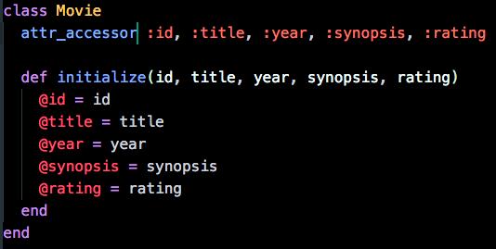
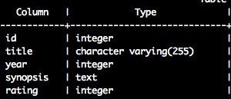
Classes are like tables…
Class: Movie
Table: movies
Classes define the structure of an object – like what attributes it has – in the form of instance variables
Tables define the structure of a certain piece of info – with attributes represented by columns

Slide 6
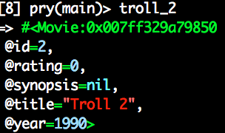
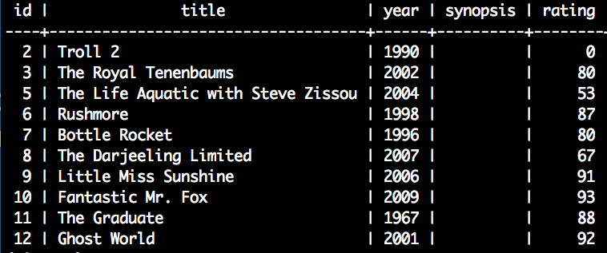
…and instances are like records
Instance:
DB Record:
id = 2
troll_2 = Movie.new
Instances are an individual object of a given type
Records are a single line item or "instance" in a table

Slide 7
ActiveRecord is an ORM
Object-
Relational
Mapping
Objects map naturally to database relations

Slide 8
Contents
What is ActiveRecord?
ActiveRecord Migrations
CRUD with ActiveRecord

Slide 9
Contents
What is ActiveRecord?
ActiveRecord Migrations -> http://edgeguides.rubyonrails.org/active_record_migrations.html
CRUD with ActiveRecord

Slide 10
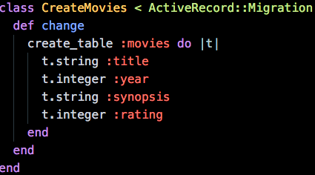
ActiveRecord Migrations help us create schemas

Slide 11
Contents
What is ActiveRecord?
ActiveRecord Migrations
CRUD with ActiveRecord

Slide 12
CRUD
.create
Takes a hash of attributes
attempts to persist those attributes on the model
.update_attributes
takes a hash of attributes
attempts to update the ‘key’ attributes with their associated value
.destroy
Kaboom.

Slide 13
Querying
.find
takes a primary key, returns object or ActiveRecord::RecordNotFound
.find_by
returns the first element that matches
.where
where(“wingloading = ?”, params[:wing])
NOT where(“wingloading = #{params[:wing]}”)

Slide 14
Querying (II)
Chaining
Plane.where(wingloading: 10).find_by(pilot_name: “fred”)
Pure SQL
Plane.where(“pilot_name ILIKE %bob%”)
Optimization
Plane.all

Slide 15
More AR Methods
.order
sorted_articles = Article.order(created_at: :desc)
.limit
articles = Article.limit(3)
.offset
articles = Article.limit(10).offset(5)

Slide 16
Example Time!
https://github.com/LaunchAcademy/sinatra-activerecord-starter-kit
Naming Convention Practice http://ar-naming.herokuapp.com/

